Slide 1
Robotics Project
Ryan Basile, Julia Salerno, Jolie Lubalin

Slide 2
Challenges we faced
Human Error
Placing the robot in the exact starting position or it would throw off the run
Robot Difficulties
Battery dies very quickly
Went off course even if aimed properly
Time
Room and course availability

Slide 3
Roles
Team Leader – Julia
Programmer – Jolie
Recorder - Ryan

Slide 4
What we have learned about Software Engineering
It’s a lot of trial and error
Teamwork helps so much
Takes a lot of paperwork to explain what is being developed
Some projects may seem easy but take a while to prefect
The programming app is not perfect
Ex: the slider to set speed of robot is very glitchy

Slide 5
What we would do differently
Make sure to charge the robot more
Record more of the test runs
Review the System Design Document more thoroughly for errors
Try using a different robot
Our robot would occasionally run identical code differently even if aimed and placed in the exact same position

Slide 6
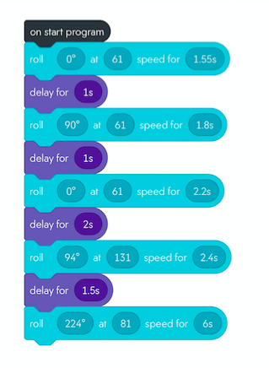
Block Code - Sprint 3 Agility

Slide 7
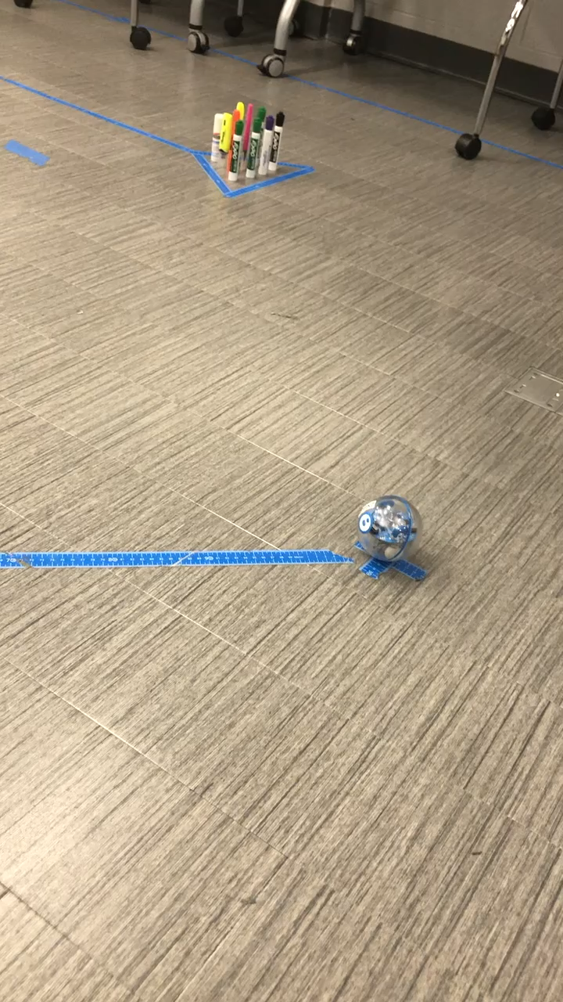
Video of Agility Sprint:

